Slide 1
Visualization on
dataset
Group 1
Abidzar M. G. Kurniawan 23521007
Ihsan Fauzi 23521024
Adi Wahyu Candra Kusuma 23521048
Irfan Nugraha 23522004
Hollyana Puteri Haryono 23522013
This slide is created to fulfill the assignment for the IF6170 Data Visualization and Narrative course.

Slide 2


Background
Netflix markets films and series to various countries by selecting countries primarily based on cultural similarities, consumer prosperity, and internet accessibility.
Netflix markets its films and series according to the segments of each country, which can be the preferred genres in each country.
Netflix also focuses on adding more languages to its system, thus supporting several countries with different languages for the films or series it markets.
1
3
8
10
13
15
17
2
4
9
11
14
16
18
NOV 6 - ARCANE
NOV 12 – RED NOTICE

Slide 3
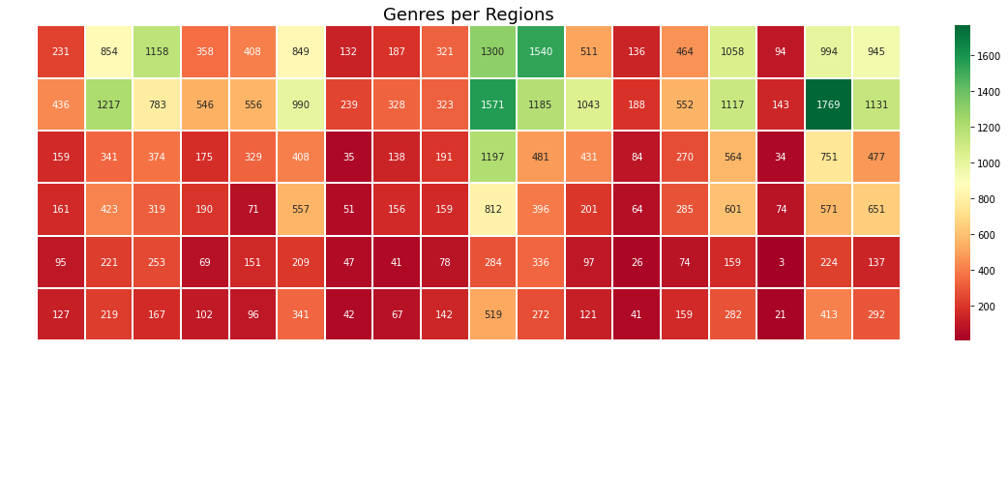
GENRES THAT ARE INCLUDED IN THE TOP 10 MOVIES/SERIES IN EVERY REGION
The genre calculation is based on films/series that make it into the top 10 in each country and is grouped by region each week.
The only region that has a high number on comedy in TOP 10: Nothern Europe
Notes:
Berdasarkan data top 10 untuk setiap negara, kami mencoba mencari tahu bagaimana minat pendudukn setiap negara terhadap masing-masing genre.
Perhitungan genre dihitung dari film/series yang masuk ke dalam top 10 di setiap negaranya dan dikelompokkan berdasarkan region di setiap minggu.
Terlihat bahwa sebagian besar region memiliki drama atau action yang menjadi top genre di setiap regionnnya. Disini kami melihat suatu hal yang menarik, yakni pada region Northern Europe, comedy juga termasuk genre yang sangat disukai, berbeda dengan region lainnya. Kemudian kami memutuskan untuk melihat lebih jauh lagi

Slide 4
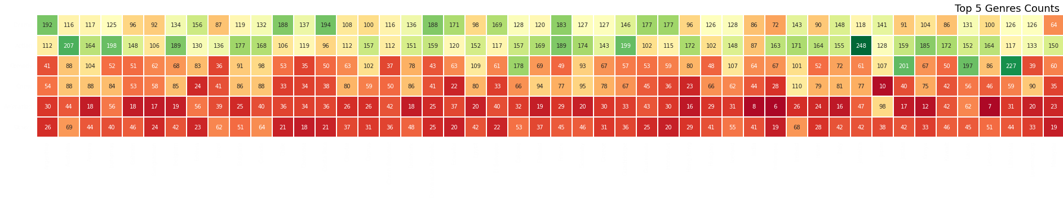
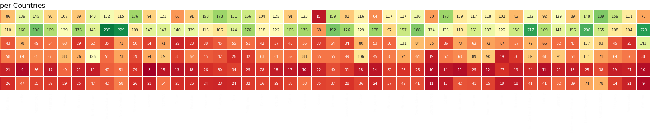
GENRES THAT ARE INCLUDED IN THE TOP 10 MOVIES/SERIES IN EVERY COUNTRY
The genre calculation is based on films/series that make it into the top 10 in each country every week.
Drama or action aren’t the highest genre in these countries, but comedies is the highest instead.
Russia doesn’t have any top genre.
Notes:
Kami mencoba memecah berdsarkan per negara, ternyata disini Estonia, Jordan, Latvia, dan Lithuania memiliki comedy sebagai genre yang tertinggi. Seperti pada region tadi, ini terlihat lebih jelas bahwa drama dan action menjadi yang tertinggi di hampir setiap negara kecuali keempat negara ini. Kemudian kami menemukan hal yang menarik, yaitu pada bagian bawah bisa dilihat bahwa russia tidak memiliki top genre, angkanya cenderung sangat kecil untuk setiap genre.

Slide 5
“COMEDY COUNTRIES” TOP MOVIE/SERIES
Comedy FIlm/Series
Estonia, Jordan, Latvia, Lithuania are countries whose number 1 genre is Comedy.
The most popular comedy series are "The Office" and "Friends."
Estonia
Jordan
Latvia
Lithuania
1
Stranger Things
Friends
Friends
The Office
2
The Office
Stranger Things
Stranger Things
Friends
3
Friends
You
The Office
Stranger Things
4
New Amsterdam
The Witcher
New Amsterdam
New Amsterdam
5
The Circle
Bridgerton
The Circle
Sex Education
Notes:
Untuk keempat negara yang sudah dimension tadi, sebut saja sebagai comedy countries. Nah Kami mencoba mencari tahu apa sih top 5 movie/series di keempat negara ini, e Ternyata ini adalah top 5 di masing-masing negara. Kita bisa melihat secara sekilas bahwa series comedy seperti the office dan friends berada di peringkat 1 s.d. 3, bersaing dengan stranger things. Dapat disimpulkan bahwa memang keempat negara ini sangat berminat dengan kedua series ini. Kemudian perlu digarisbawahi, bahwa estonia, latvia, dan lithuania merupakan bagian dari region yg sama, yaitu northern europe, yang tadi kita lihat memiliki genre comedy yg tinggi.
Estonia -> Stranger Things 2x lipat The office
Stranger Things 96
The Office (U.S.) 44
Friends 41
Manifest 27
Better Call Saul 26
Jordan
Friends 156
Stranger Things 90
Manifest 29
You 24
Till Death 18
Latvia
Stranger Things 98
Friends 53
The Office (U.S.) 37
Manifest 27
Bridgerton 26
Lithuania
Stranger Things 96
The Office (U.S.) 75
Friends 53
Bridgerton 26
Sex Education 26

Slide 6
RATINGS
These ratings are based on three rating websites, namely IMDb, Rotten Tomatoes, and RatinGraph.
The ratings for "The Office" and "Friends" are considered quite good according to several ratings.
The Office
Friends
1
IMDb
9.0/10.0
8.9/10.0
2
Rotten Tomatoes
89/100
93/100
3
RatinGraph
8.1/10.0
8.3/10.0

Slide 7
DIFFERENCE AND SIMILARITY
The Office
Friends
1
Creators
Greg Daniels, Ricky Gervais, & Stephen Merchant
David Crane & Marta Kauffman
2
Release Date
24 March 2005
22 September 1994
3
Seasons
10
9
4
Subgenre
Sitcom
Sitcom
5
Duration
< 30 minutes
< 30 minutes

Slide 8
FILM CHARACTERISTICS
Mockumentary When characters interact directly with the audience through the camera, it makes the show stand out compared to others because it makes the show feel much more real. Characters ask questions to the audience, speak to the camera like humans, and behave very normally, making it easy to forget that you're watching a TV show.
Bringing Drama, But Still Rich in Comedy The series will make a strong effort to build highly emotional moments very well, with a touch of humor to remind you that it's still a comedy.
The Cast Has Amazing Chemistry The cast can build chemistry well with both few and many co-stars.
Running Gags Using the same joke phrases in every season by one of the characters, this shows the interconnectedness of each season.
The Office

Slide 9
FILM CHARACTERISTICS
Funny and Relatable Characters Each character has their own unique qualities.
Lesson Learned Despite the humor and sarcasm that define the series, each episode of Friends essentially ends with a life lesson. The most important, of course, is always relying on your friends and not caring too much about what others think.
Celebrity Cameos Friends features many cameos from some of the biggest current Hollywood stars.
Iconic 1990s Style Friends incorporates 1990s fashion into the series, a style that continues to inspire current fashion trends.
Its Timeless Theme Song and Opening Credits Using an iconic, easily remembered theme song that was specifically created for the series.
Friends

Slide 10


IMDB REVIEW WORDCLOUD
The Office
Friends

Slide 11
WHAT SHOULD YOU DO?
Comedy series like "The Office" and "Friends" have been quite successful, so it would be a good idea to market similar comedy series in Estonia, Lithuania, Latvia, and Jordan. These two series can serve as examples for creating comedy series on Netflix.
Key characteristics in the creation/selection of comedy series:
❗ Unique, emotional, relatable character portrayal, as well as chemistry among characters.
The theme of the show itself (theme song or fashion style).

